Slide 1
Employee Wellbeing Plan
For [your company name here]
Add your logo

Slide 2
About this template
This template has been designed for you to use alongside the information in our all-in-one employee wellbeing guide.
We hope by the end of this you’ll have everything you need to start building or rebuilding your employee wellbeing strategy!

Slide 3
1. Understanding your workforce

Slide 4
Analysis of your workforce
QUESTION | ANSWER
How many employees do you have? | [Insert your answer here]
How many locations are your employees based in? | [Insert your answer here]
How much are you expecting this to grow in the next 18-24 months? | [Insert your answer here]
What are the demographics of your workforce? | [Insert your answer here]
What do you currently do when it comes to workplace wellbeing? | [Insert your answer here]

Slide 5
Workforce survey
Create a survey to send out to your team. Here are some sample questions to get you started:
What are your thoughts on our current wellbeing offering?
What do you think is missing from our wellbeing offering?
How much do you think senior management care about wellbeing?
Have you experienced burnout while working here?
How big of an issue do you think burnout is in our workplace?
What does wellbeing mean to you?
What wellbeing issues do you personally face?
What wellbeing issues do you think our company faces?
Is there anything you’ve seen or heard other companies doing that we should?

Slide 6
Key problems
Based on your workplace analysis and survey findings what are your key challenges?
01
[Note about key problem]
[Note about key problem]
[Note about key problem]
[Outline your key problem here]
02
[Note about key problem]
[Note about key problem]
[Note about key problem]
[Outline your key problem here]
03
[Note about key problem]
[Note about key problem]
[Note about key problem]
[Outline your key problem here]

Slide 7
2. Defining what success looks like

Slide 8
[Insert problem 1 here]
Set a goal on how you’ll overcome your problem, how you intend to measure it and what sort of results you expect.
GOAL
METRIC
OUTCOME
[Add your goal here]
[Add how you’re going to measure impact — what metrics will you track?]
[Outline what outcomes you expect to see]

Slide 9
[Insert problem 2 here]
Set a goal on how you’ll overcome your problem, how you intend to measure it and what sort of results you expect.
GOAL
METRIC
OUTCOME
[Add your goal here]
[Add how you’re going to measure impact — what metrics will you track?]
[Outline what outcomes you expect to see]

Slide 10
[Insert problem 3 here]
Set a goal on how you’ll overcome your problem, how you intend to measure it and what sort of results you expect.
GOAL
METRIC
OUTCOME
[Add your goal here]
[Add how you’re going to measure impact — what metrics will you track?]
[Outline what outcomes you expect to see]

Slide 11
3. Setting and allocating budget

Slide 12
Calculate your current costs
We’ve asked you to put in the cost of employee attraction so you can see how much it costs to replace an employee.
LINE ITEM | COST
EMPLOYEE ATTRACTION COSTS
Job board posting and advertising | [Insert your cost]
Recruitment costs | [Insert your cost]
Time cost to recruit (Estimation of hours spent interviewing multiplied by the hourly salary of the people doing the interviews) | [Insert your cost]
EMPLOYEE ONBOARDING COSTS
Time to onboard (Estimation of hours spent to send contracts, check references (etc.) multiplied by the hourly salary of the people doing onboarding) | [Insert your cost]
Employee training (Time spent training employees multiplied by the hourly salary of the people doing the training and employees being trained) | [Insert your cost]
TOTAL | [Insert your total]

Slide 13
Calculate your current costs
LINE ITEM | COST
EMPLOYEE ENGAGEMENT COSTS
Employee perks and benefits per employee (This can include everything from coffees, team lunches and drinks, to core, voluntary and flexible benefits) | [Insert your cost]
Employee rewards per employee (this can include everything from gift vouchers to tangible rewards) | [Insert your cost]
Employee engagement tools | [Insert your cost]
TOTAL | [Insert your total]
Making a place your employees love to work is important. The more engaged and motivated your employees the more likely they are to stay!

Slide 14
Rough budget allocation
LINE ITEM | COST
ENGAGEMENT INVESTMENT PER EMPLOYEE (Take your employee engagement costs and divide it by your number of employees)
Total employee engagement costs | [Insert your cost]
Number of employees | [Insert your cost]
TOTAL | [Insert your total]

Slide 15
4. Selecting the platform that’s right for you

Slide 16
An expanding offering comparison
FEATURE | Perkbox | [Alternative 1] | [Alternative 2]
Wellbeing content is regularly growing Provider adds new content on a monthly basis | ✅
Tools help with all three pillars of wellbeing Employees can access resources for physical, mental and financial wellbeing | ✅
Financial help can be given in multiple ways Employees can choose from vouchers, online codes or be gifted points | ✅
Physical and mental help can be given in multiple ways Employees have access to exclusive interviews with wellbeing experts. workout videos, meditations, sleep stories and more! | ✅

Slide 17
Streamlining comparison
FEATURE | Perkbox | [Alternative 1] | [Alternative 2]
Everything in one place Have a centralised system for both admins and employees | ✅
Consistent employee experience Give everybody the same user experience, allowing you to create a more unified EVP | ✅
Integrates with HRIS providers Integrate with Workday, HiBob, BambooHR, Microsoft Azure, Okta, Google Workspace, Fourth, Rippling and more! | ✅
International equity Be fair in your wellbeing offering to every employee in every location | ✅

Slide 18
User-friendly experience comparison
FEATURE | Perkbox | [Alternative 1] | [Alternative 2]
Available to your employees via web or mobile app Employees can log in via web or mobile app – anytime, anywhere | ✅
Set favourites and customise the platform Employees can save their favourite content and set their interests | ✅
Single Sign-On Lets your employees use one password via Okta, Google Workspace, Microsoft Azure, JumpCloud, VMware, OpenID, OneLogin and more! | ✅

Slide 19
Robust reporting comparison
FEATURE | Perkbox | [Alternative 1] | [Alternative 2]
Usage reporting See how often your employees are using the platform | ✅
Industry benchmarking See how your platform is used compared to other companies in your industry | ✅
Top wellbeing resources See what type of content and what financial discounts are most popular — by country, team and month | ✅
Download reports Download reports as an when you need | ✅

Slide 20
Data security comparison
FEATURE | Perkbox | [Alternative 1] | [Alternative 2]
ISO 27001 accredited Follows international standard on how to manage information security | ✅
Cyber Essentials accredited Follows the United Kingdom standard on protection in cyber security | ✅
PCI-DSS accredited Follows the Payment Card Industry Data Security Standard on how to handle branded credit cards from the major card schemes | ✅
Privacy policy Has a statement or legal document that discloses some or all of the ways a party gathers, uses, discloses and manages data | ✅
GDPR compliant Follows the regulation of EU law on data protection and privacy in the European Union and the European Economic Area | ✅

Slide 21
5. Getting managerial buy-in

Slide 22
Your presentation to managers
We understand that getting managerial buy-in can be a little tough, so feel free to use some of the previous slides to help you create your presentation deck for stakeholders.
We’ve also added a few slides too help you show the value of Perkbox as an all-in-one benefits and rewards platform for your business.

Slide 23
Perkbox is a global benefits and rewards platform
that allows companies to care for, connect with and celebrate their employees,
no matter where they are or what they want.

Slide 24
Perkbox work with amazing businesses

Slide 25
The 2022 reality
Standard benefits are no longer enough
Attracting and retaining talent is harder than ever
Wellbeing continues to be at the forefront
9 in 10 (87%) Gen Z employees say it’s important that benefits are tailored to them as an individual.
The global talent shortage is the highest since 2006
According to Gallup, 60% of people are emotionally detached at work and 19% are miserable.

Slide 26
The HR resource drain
Trying to build a strong EVP isn’t easy — especially across borders!
Multiple providers, complex regulations or managing different vendors
time
Piecemeal solutions, complicated plans or inefficient spend
money
Multiple logins, password fatigue or multiple data upload processes
energy

Slide 27
That’s why we designed Perkbox...
A single global platform that:
Saves HR teams time, money and energy &
provides a seamless experience for their employees with one app

Slide 28
How can Perkbox help you?
Support employee wellbeing...
Harmonise benefits...
"For businesses serious about employee wellbeing they will be very surprised at the complete package on offer. Commercially, it's a no brainer."
David Sheridan, Arc
"I was really impressed by what I saw with Perkbox. It was clear that it was a global solution that could fix a lot of our challenges."
Cressida Sergeant, Traveltek
Provide something for everyone...
Build a culture of appreciation…
"The best thing about the platform is that it’s so versatile. There’s something for everyone."
Victoria Otosio, Purplebricks
"From my perspective as an employer, it’s helped me to feel that I can give back and I feel able to express how appreciative I am of my team."
Susie Campbell, Hullabaloo PR

Slide 29
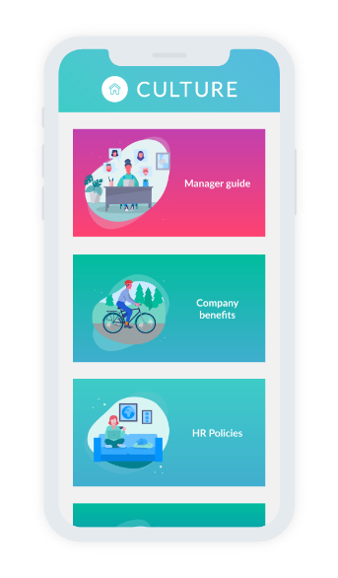
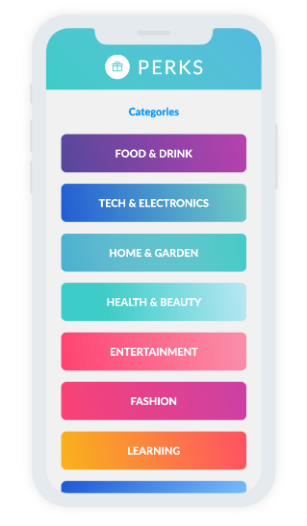
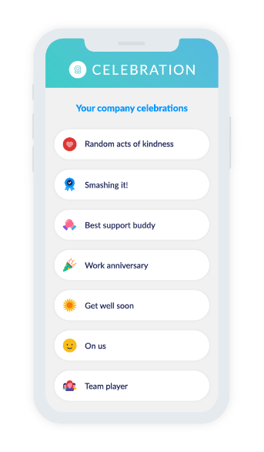
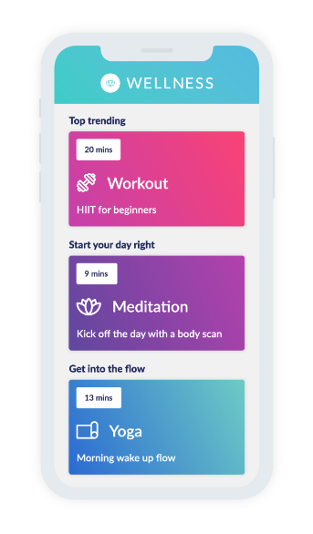
The Perkbox platform

Slide 30
The Perkbox platform
Caring for, connecting with and celebrating your employees across the globe
Showcase your company updates and culture across locations from one central place.
Support your team's wellbeing with curated resources at their fingertips.
Recognise and reward your people in a personalised way, wherever they are — increasing motivation and engagement.
Provide global perks and benefits that constantly add value to your employees’ lives, all in one easy to manage place.
Admin

Slide 31
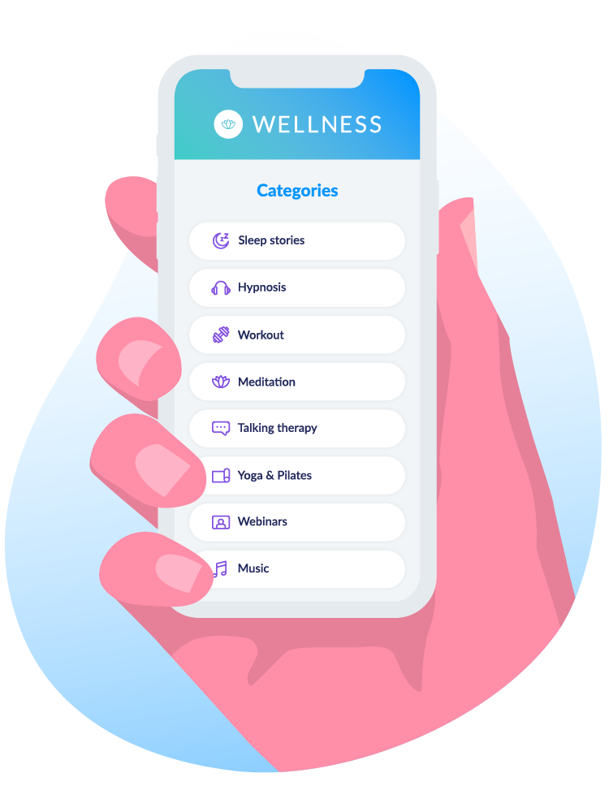
Wellness hub
A constantly updated collection of curated wellbeing content, helping you give your employees the resources they need to be happy and healthy.
Emphasise your company focus on wellbeing
Provide your people with a range of ad-free content covering everything from workout videos, to meditation guides, to talking therapies
Available anywhere, at any time — laptop, tablet, smartphone or smartwatch

Slide 32
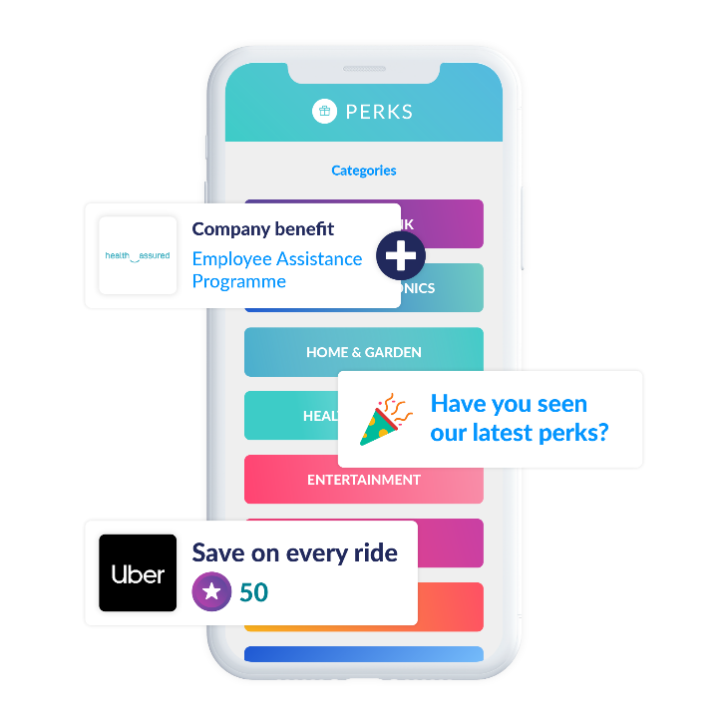
Perks hub
Provide a variety of perks, benefits
and discounts that add value to
your employees’ lives all year round.
Show you care about everyone’s needs with discounts and benefits to suit all lifestyles
Give your people Flexi points to spend on premium Flexi Perks at no cost to them
Available across all locations via a global app
Showcase your existing benefits, tailored to each team and location

Slide 33
1000s of perks across the globe…
Shopping
Entertainment
Food and drink
Wellbeing
Lifestyle
For more information check out the Perks catalogue

Slide 34
Perks hub
Flexi Perks
“I switched from Spotify to Deezer!”
Empower your people with a selection of extras at no cost to them.
Employees choose from a variety of Flexi Perks — from a cup of coffee to annual streaming subscriptions
Empower your people by letting them decide what they spend their points on
Flexi Perks are available in all locations so you can ensure there’s something for everyone
Employees can spend the points right away or save them up for a more expensive Flexi Perk

Slide 35
What your Flexi points could buy
10-20
30-50
60-100
Cinema Tickets

Slide 36
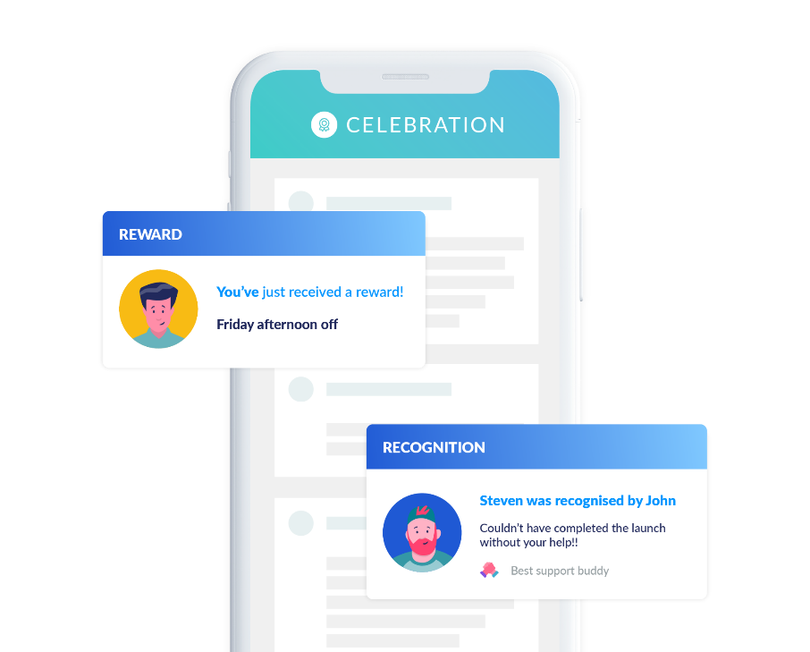
Celebration hub
Recognise and reward your people in a personalised way to increase motivation and engagement.
Show appreciation by celebrating milestones or a job well done with recognition
Reward your employees in seconds, anywhere in the world
Discover top performers and build engagement via polls
Link recognitions to company values to emphasise what you stand for
Recognise great work right where collaboration happens with the Perkbox app for Microsoft teams

Slide 37
NEW! Perkbox for Microsoft teams
Strengthen your culture by celebrating great work right where the collaboration happens
The Perkbox app for Microsoft Teams brings Perkbox into your team workflow, making your recognition initiatives more visible and accessible for your employees

Slide 38
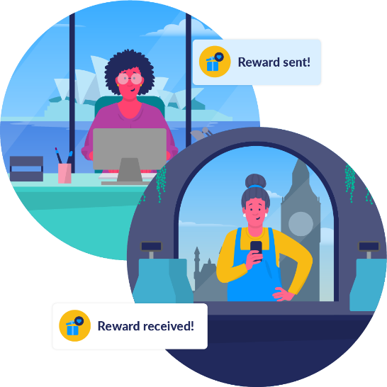
NEW! Supercharge your EVP with Global Reward
Use Reward points to show your appreciation for any employee, in any location — allowing you to build a truly global reward strategy.
Empower your people by giving them a huge range of options to spend their reward points on
Remove the headache of working out how to reward across locations
Simplify the process of sending rewards and allocating your reward budget across teams and departments

Slide 39
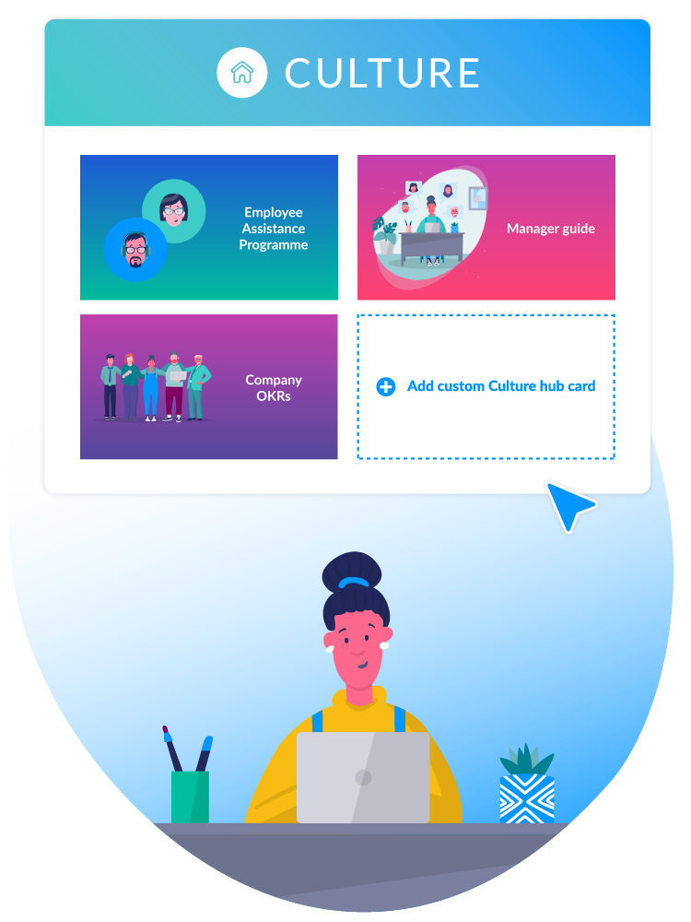
Culture hub
A central place to showcase your culture and people initiatives across locations.
Utilise a single source for all important news and people initiatives
Link to key resources such as town hall recordings, company policies and company values
Create better cultural alignment across locations
Build better connections between employees and senior leadership
Reduce the need to cascade news through multiple layers

Slide 40
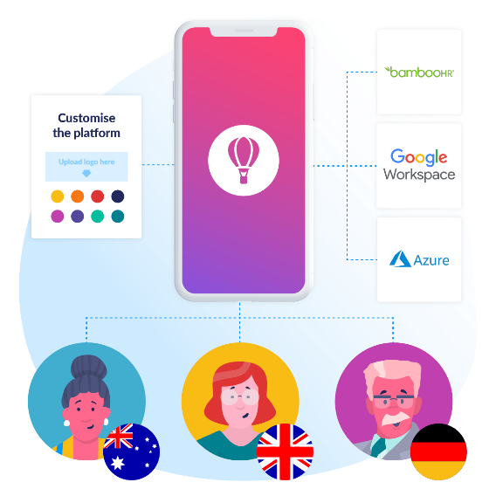
Admin hub
Harmonise your EVP across locations
while minimising admin burden — saving you time, energy and money.
Seamlessly manage users from one global platform and significantly reduce costs
Remove manual updates and automatically onboard/offboard by integrating with your HR directory
Integrate with your SSO provider for easy login
Customise branding and benefits by team and region
Receive in-depth reporting on how the platform is used

Slide 41
Want to learn more about Perkbox?
Book a group demo today!
Book a demo

